Slide 1
Greeks, Persians and Alexander the Great
S&E YEAR 7 JWO 6.10

Slide 2
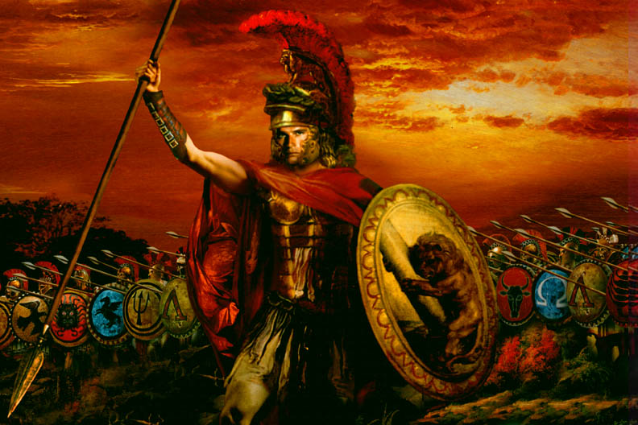
Contents
The Persian wars
The Battle of Marathon
The Peloponnesian Wars
Alexander the Great
Activity

Slide 3
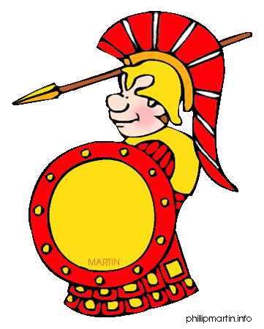
The Persian Wars
Greek city-states previously at war with ________ _________
United to take on Persians
Defeated much larger armies and forces from _________
Saved Greece from being taken over

Slide 4
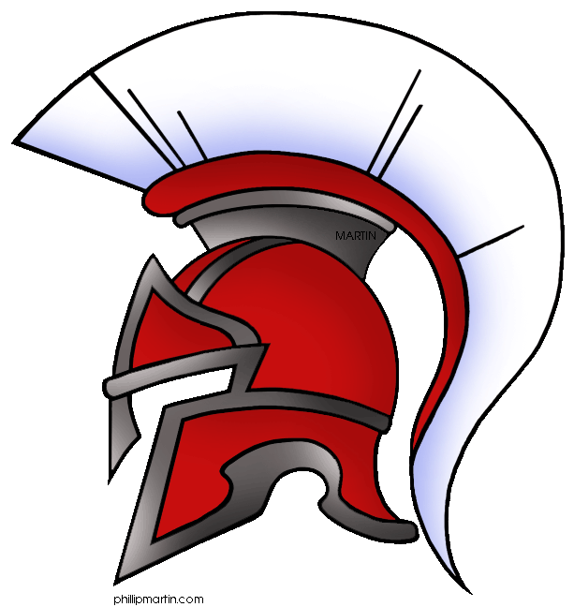
The Persian War
Persia was the land we now call Iran
Controlled a great Empire
Anatolia (modern Turkey)
Palestine
________
________
499 BCE Greek cities of Anatolia (islands on east of Greece) with help from Athens revolted against Persian control
Revolt ______ – Greek islands still controlled by Persia

Slide 5
Persian Empire

Slide 6
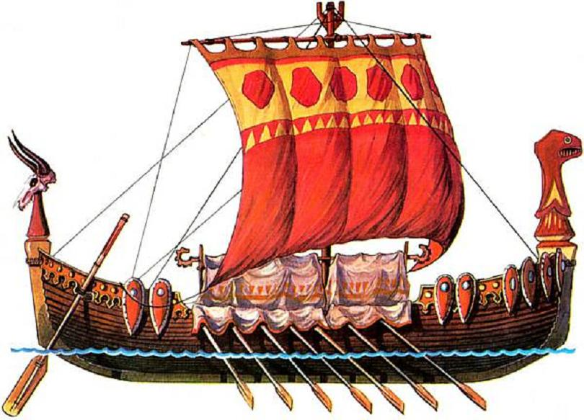
Battle of Marathon
King Darius I of Persia wanted to punish Athens for ____________ ____ _____________
In 492 BCE sent a fleet to invade. Ships wrecked in ________
King Darius I demanded Athens and Eretria submit to him (let him take control). They refused
Sent another fleet carrying large Persian army
Captured Eretria and landed on the plain of Marathon in 490 BCE

Slide 7
Battle of Marathon
10 000 Athenians and allies defeated 20 000 - 50 000 Persians in a ___________ _____________
Greeks charged downhill straight at the Persians
Hero Pheidippides
Before the battle he ran for 2 days and nights (over 240kms) from Athens to Sparta to get help
Then he fought in Battle
After he ran the 42km from Marathon to Athens non-stop
As he arrived he passed on the news of victory and died
Modern marathon same _____________
http://misswilliamsons.weebly.com/ch-6-resources.html

Slide 8
A Second Invasion
King Darius I dies in 486 BCE – his son Xerxes took over
480 BCE Persian army of spearmen, archers and hoplites marched into Greece. Supported by a fleet sailing down the coast.
____ Greek states united against the Persians
Athens led the _______ and Sparta led the ______ __________
At Thermopylae the Spartan King Leonidas delayed Xerxes’ advance with a much smaller army than the Persians they held off
http://misswilliamsons.weebly.com/ch-6-resources.html
Also great battles at sea where Persia was eventually defeated

Slide 9
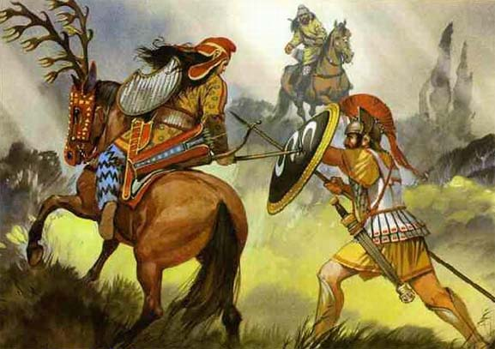
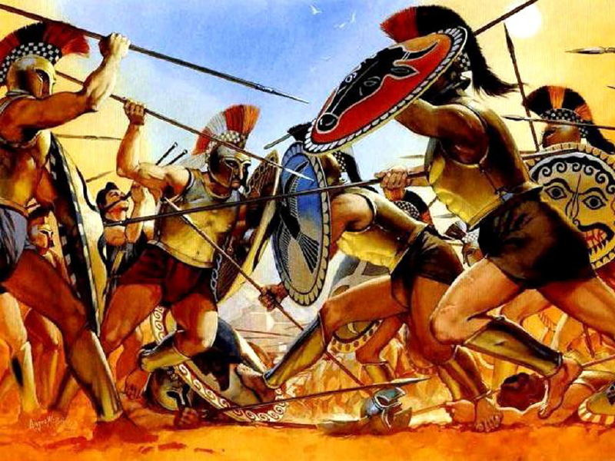
The Final Battles
479 BCE in Plataea - Spartans led a large Greek army in destroying and even larger Persian force
Greeks sailed to Anatolia where they also defeated the Persians
Fighting continued for many more years but the Greeks no longer feared a _______ ______________

Slide 10
The Peloponnesian Wars
After being __________ against Persia, Greeks went back to fighting with each other
Two Peloponnesian Wars 460 - 445 BCE and 431 - 404 BCE
Colonies dominated by Athens VS those who allied with Sparta
Sparta, with help from __________, forced Athens to surrender which ended the 2nd war
Sparta controlled Greece until city-state of Thebes defeated the Spartans in 371 BCE

Slide 11
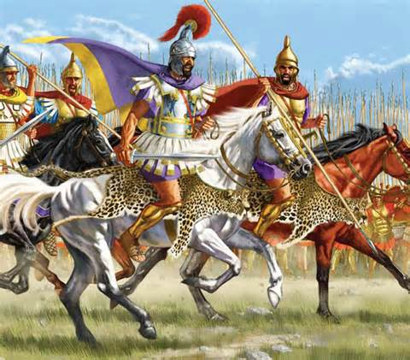
Alexander the Great
Greek city-states were ________ due to constant fighting with each other
Invaded and conquered by Philip of Macedon in 338 BCE
Philip murdered two years later and his son Alexander became ruler of Macedon and Greece

Slide 12
Alexander the Great
Born 356BCE and died 323 BCE
Became ruler in 336 BCE
Thebes tried to revolt and Alexander crushed the city
Killed 6000 of it’s people, enslaved the rest
334 BCE Alexander led army eastward and invaded the _____________ ___________
Defeated King and seized control

Slide 13
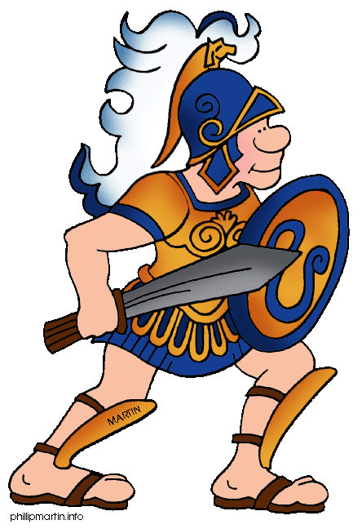
Alexander the Great
The era of city-states in Greece ended
Spread Greek ________ throughout places he conquered – all the way to _________
Meant that Greek culture and oral history survived

Slide 14
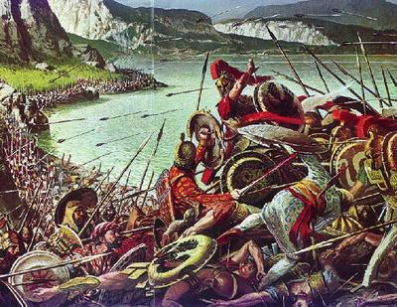
Activity
Create a timeline including the important events described in this slide show

