Slide 1
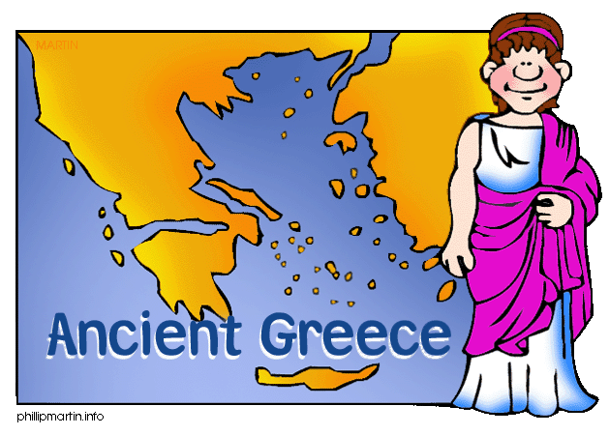
6.3 The Rise of Greek city-states

Slide 2
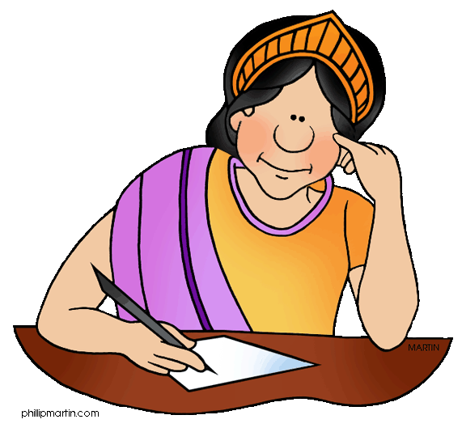
Outline
The Greek ‘Dark Age’
Archaic Period
Geography of Greece
Farming
Definitions
Activity

Slide 3
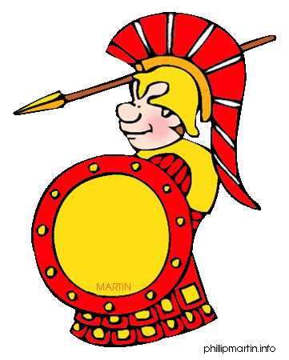
The end of the Mycenaeans
Approx. 1150 BCE
Mycenaean places were looted and burned
Citadels abandoned (apart from Athens)
Dorians take over
Less civilised
From Northern Greece
Collapse due to Dorian invasion?
OR already collapsed? Civil War?

Slide 4
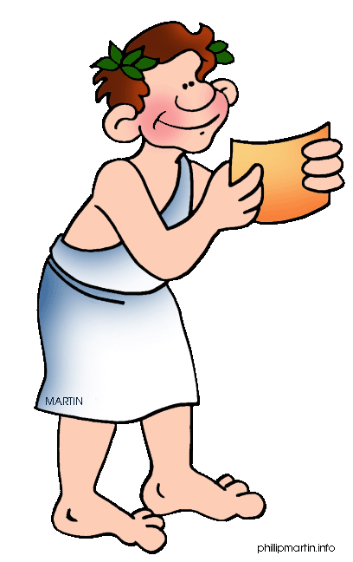
The Dark Age
Approx 1150 BCE to 750 BCE
Skill of writing disappeared
Therefore we have little evidence from this time
And why we call it the ‘Dark’ age
Iron Age reached Greece during this time
Lots of Greeks migrated to islands and coast land

Slide 5
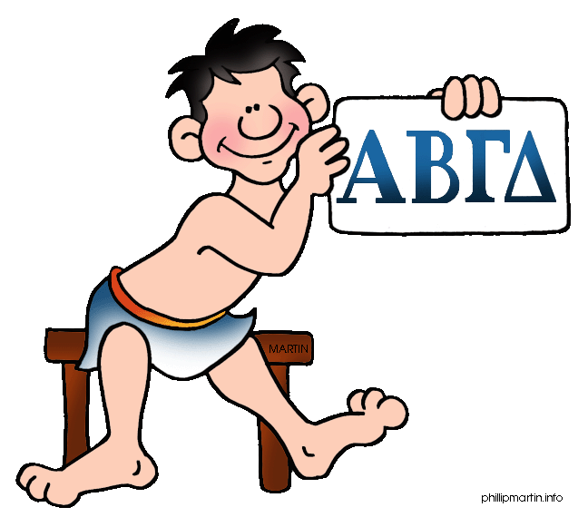
Archaic Period
Approx. 750 BCE to 490 BCE
Development of the Greek alphabet
Growth of poleis

Slide 6
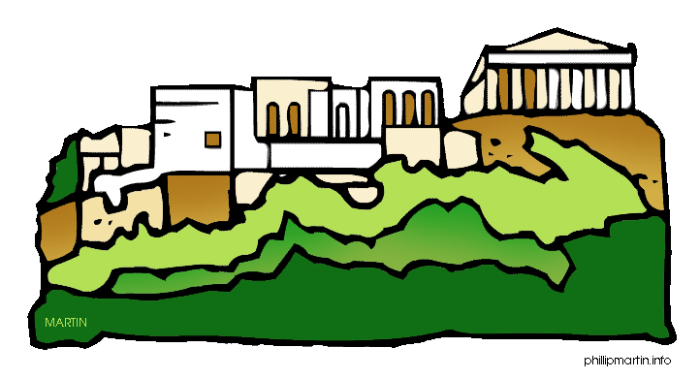
Poleis
Independent, self-governing city-states
Different government styles and ways of life
Some shared characteristics of all Greek communities
Not one unified nation
Fought each other for territory (land)

Slide 7
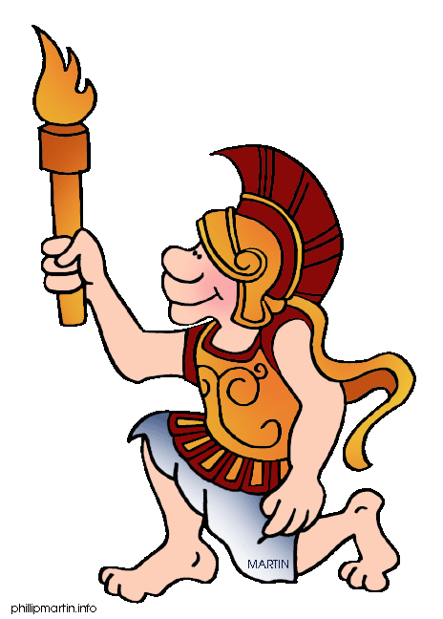
Classical Period
Changes took place around Greece
Growth of Pan-Hellenic institutions
For all Greeks (common for everyone)
Eg. Olympic festivals
Common Greek culture

Slide 8
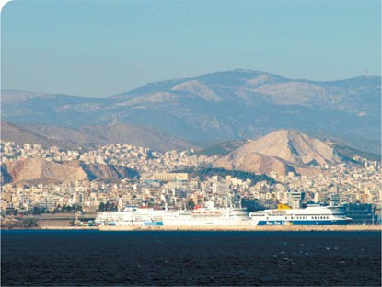
Geography of Greece
Dry, rocky and mountainous
Influences ancient civilisations
Communication, trade, central Government
Strengthens individual city-states

Slide 9
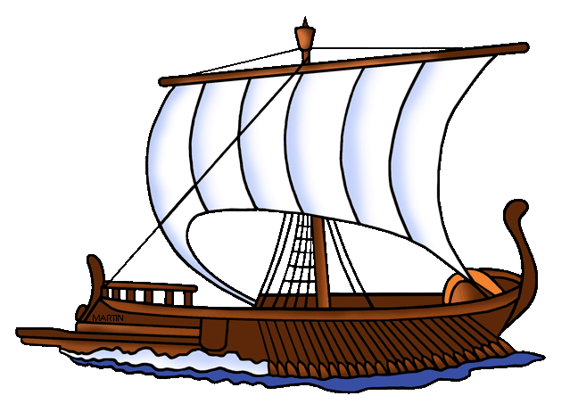
Geography of Greece
Lots of natural harbors on large coastline
Good seafarers
Trade over sea
Strong fishing culture

Slide 10
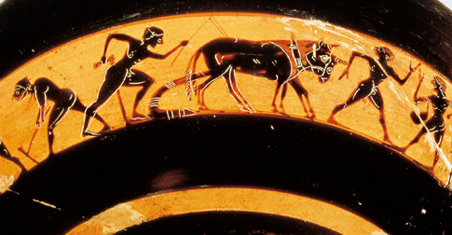
Geography of Greece
Land for farming
1/5 with good soils
Spread to settlements in other countries

Slide 11
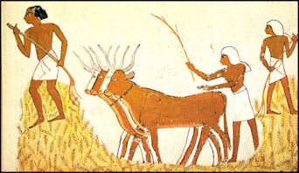
Farming
Small farms
Enough to grow to support your family
Limited trade with other city-states
Grow everything needed

Slide 12
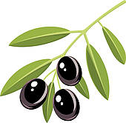
Farming
Main crops
Olives (eaten and olive oil – cooking and lamps)
Grapes (eaten and wine)
Barley (grain for food – cereal and bread)

Slide 13
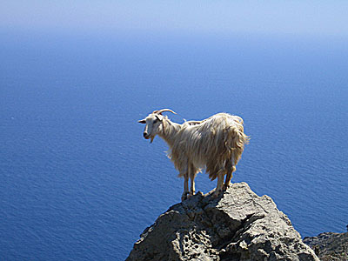
Farming
Sheep and goats
Dairy
Meat
Wool and skin for clothing

Slide 14
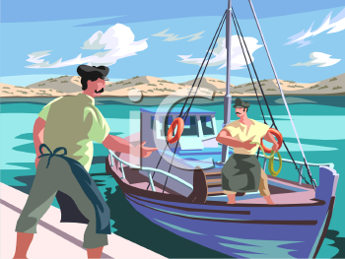
Farming
Fishing industry
Lots of coastline
Good at using boats
Fisherman trade with other locals

Slide 15
Definitions
2. Citadel – a fortress
3. Dorians – tribes from the north of Greece who moved into the south during the Dark Age
4. Iron Age – period in which people learned to use iron to make tools and weapons
5. Pan-Hellenic – for all Greeks
6. Polis (plural poleis) – ancient Greek city-state

Slide 16
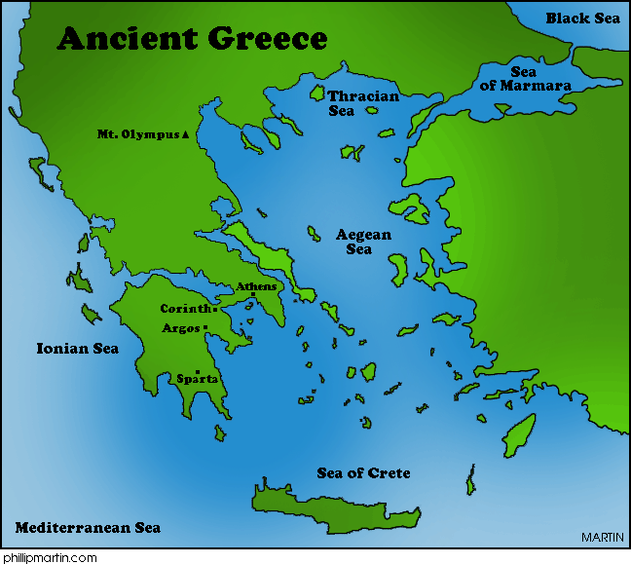
Activity
Workbook 6.2
Page

