Slide 1
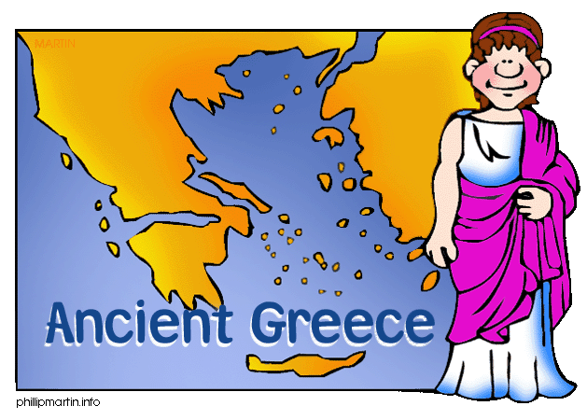
6.6 Athens – wonder of the ancient world

Slide 2
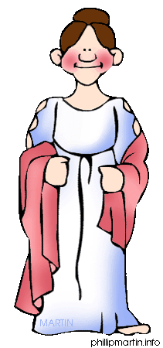
Outline
A Man’s world
Education
Housing
Public life and entertainment
Acropolis, Agora and Attica
Definitions
Video
Activity

Slide 3
Man’s World
Man most important in Athens
Made all decisions
who and when daughters would marry
If new babies live or die
Young bride (early teens), husband twice their age
After marriage, a man spent most of his time away from the home.

Slide 4
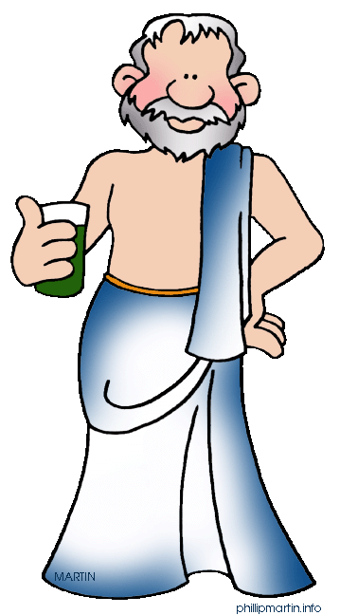
Man’s World
Government duties
Run a workshop
Work out at the gym
Meet friends at the agora
Dinner parties

Slide 5
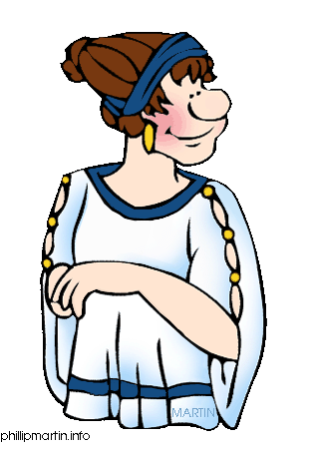
Women’s World
Spent rest of life in home
Produce children (especially sons)
Ran household (with help from salves and older daughters) [Source 2]
Marriage celebrations [Source 1]
Only party/relaxation
Celebrate with menfolk
Could attend some religious festivals and rituals

Slide 6
Source 1

Slide 7
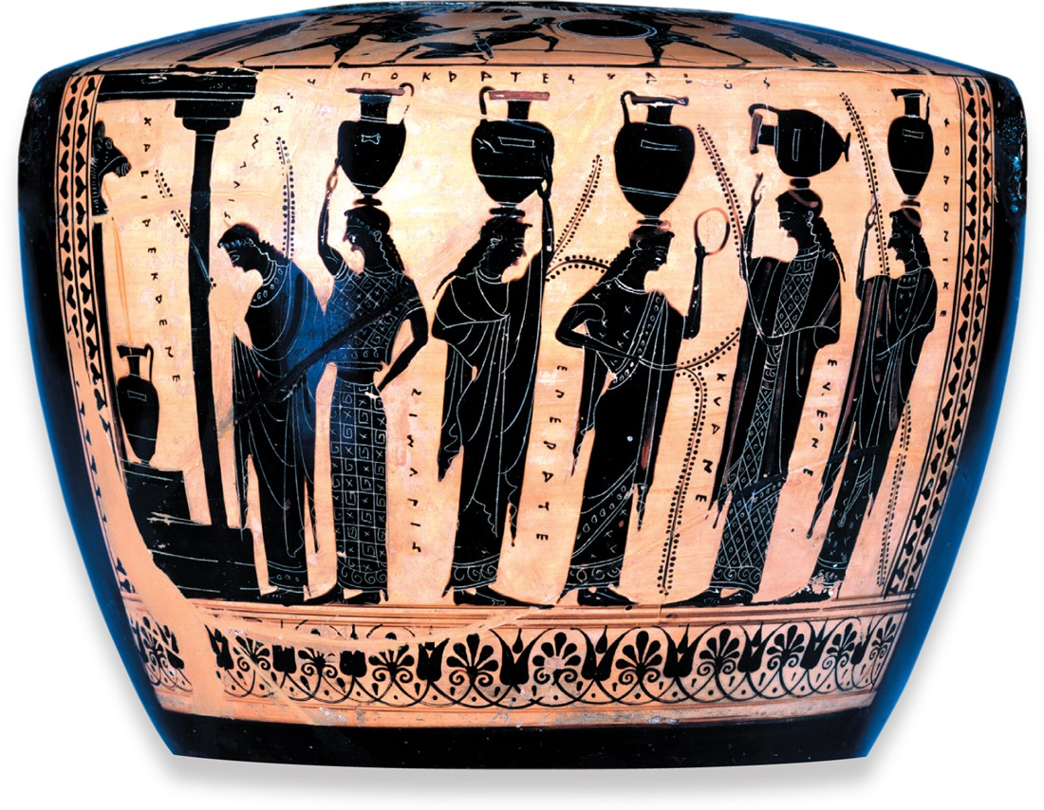
Source 2

Slide 8
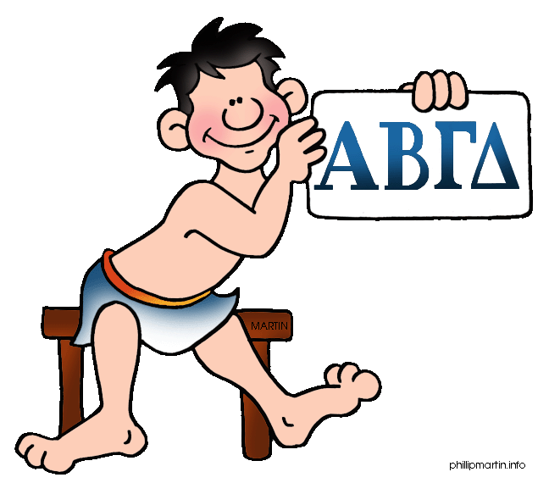
Education
Only boys from age 7
Reading and writing important skills
Poetry
Math
Music
Sport

Slide 9
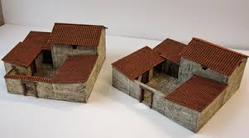
Housing
Not much difference between rich and poor
Rich used money for sporting and religious events
Central Courtyard
Bathroom
Stone floor instead of earth
Sun-dried bricks
Rooms faced inwards
Sparse furniture
Men and women lived
separately

Slide 10
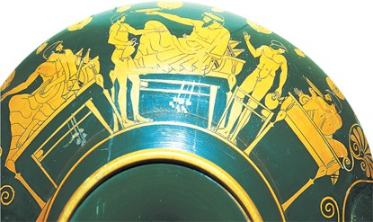
Public Life
Enjoyed by men
Banquets important and common
Food – Fish, vegetables, cheese and wine
[Source 3]

Slide 11
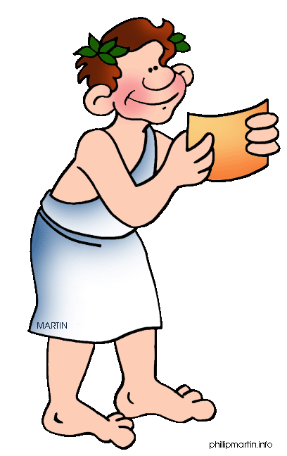
Golden Age
Peak 5th Century BCE
Athens a wealthy city
Stable democracy
Strong trade links
Culture
Civic pride

Slide 12
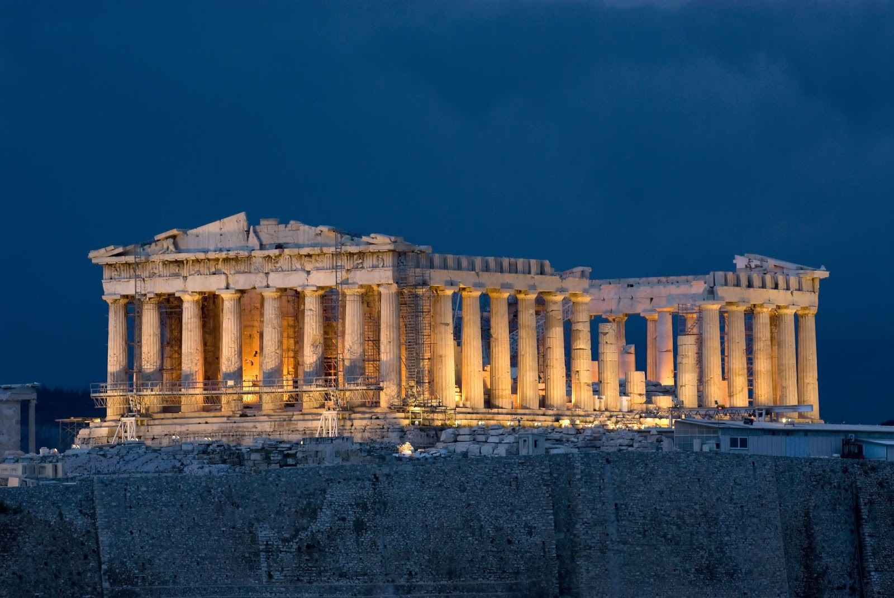
The Acropolis
Rocky hill, 150m high, centre of Athens
Largest building – Parthenon, a temple dedicated to the goddess Athena
Decorated with sculptures and carved panels
Early 19th Century
Panels removed and shipped to Britain
Today ½ surviving panels are in British Museum
Greek government is trying to get the ‘Parthenon marbles’ back

Slide 13
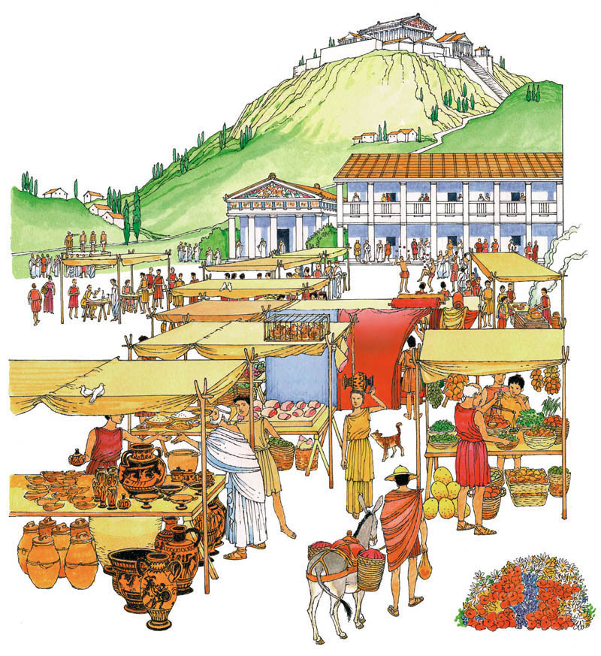
Agora
Marketplace
Below the acropolis
Public square surrounded by building
Centre for government
Shopping – food, animals, jewelry, pots, furniture etc
Listen to philosophers
Early plays before specific amphitheatres built
Chat with friends

Slide 14
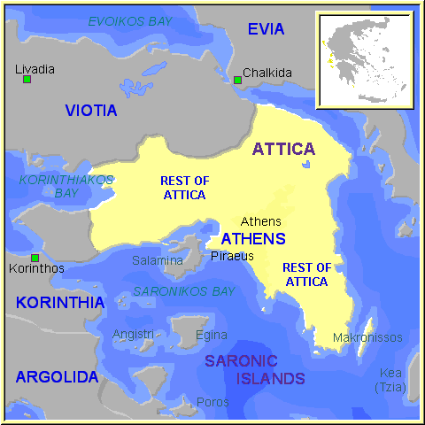
Attica
Surrounding countryside ruled by Athens
Most of population lived here

Slide 15
Farming
Attica where farming occurred
Land not suitable for crops such as grain
Imported from Egypt and Sicily (Italy)
Also imported timber and metals
Olives, grapes and figs grew well
Exported olive oil and wine
Made Athens wealthy

Slide 16
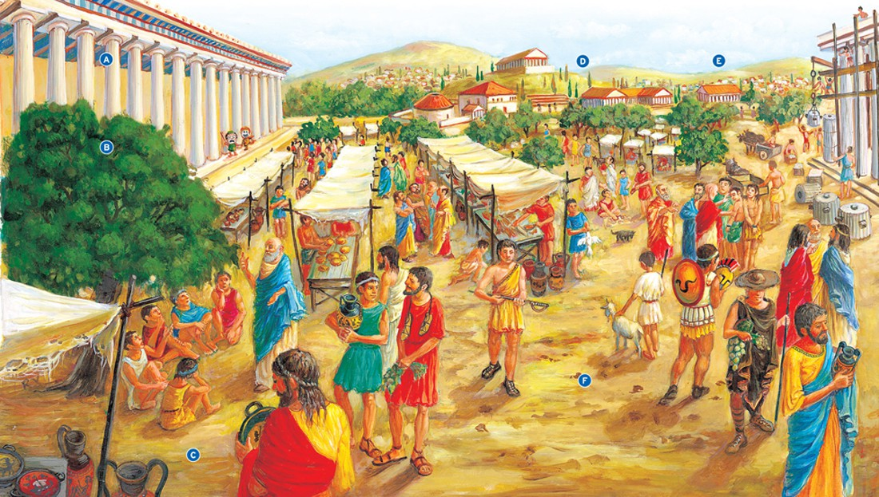
Source 5

Slide 17
Source 5 Cont
The agora was the political, legal, commercial and social heart of the city in ancient Greece.
A - Public buildings surrounding the Agora in Athens included in the law courts (Heliaea), the mint, the military headquarters (Strategeion) and the Bouleuterion (meeting place of the Council of 500).
B - Plays were first held in the Agora and later in special amphitheatres. They began as religious ceremonies in honour of the Greek god Dionysus. He was the god of wine and merriment.
C - Athenian pots were usually decorated with detailed scenes of daily life and with the stories of myths and legends.
D - Slaves were bought and sold in the Agora. A highly skilled slave might cost 6000 drachma; a simple wooden couch might cost 20 drachma. A drachma was the main silver coin of the ancient Greeks. Before coins were introduced, goods in ancient Greece were bought and sold by bartering.
E - To build columns, ropes and pulleys were used to hoist blocks of stone into position. Metal rods joined each block to the one above and below.
F - The mass of men provided an audience for philosophers such as Socrates. Works by philosophers such as Plato (Socrates' star pupil) and Aristotle (a follower of Plato) have been translated into English.

Slide 18
Definitions
15. Agora – large open space in the centre of a Greek city that served as a public meeting area and marketplace
16. Amphora – Large clay vase used to store and carry liquids such as water, wine and olive oil
17. Parthenon – Athenian temple dedicated to the goddess Athena

Slide 19
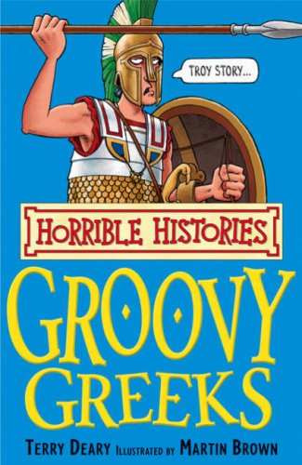
Videos
http://misswilliamsons.weebly.com/ch-6-resources.html

Slide 20
Activity
Image you are living in Athens. Who are you?
Write a short paragraph or letter about your daily life considering the following things
Are you male/female?
Are you/your household wealthy or poor?
How do you/your family earn money?
How do you spend your day?
If you are male, consider what might be debated in the Assembly or if you have served in the army.

